Slide 1
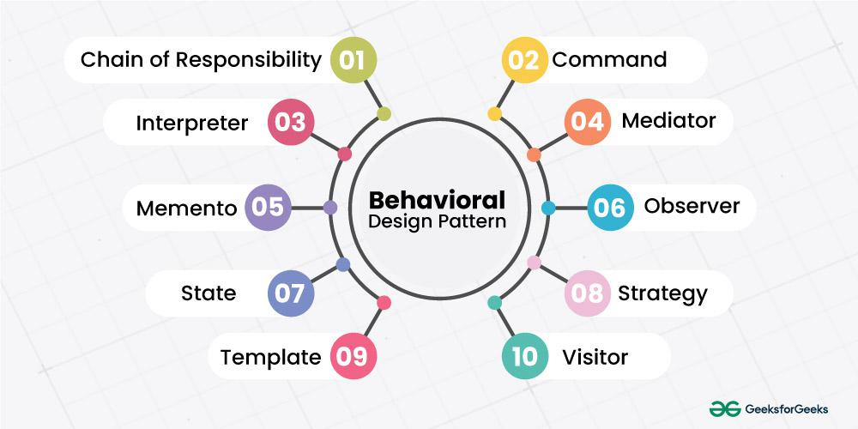

Slide 2
Behavioral Design Pattern
Behavioral design patterns in Java are a category of design patterns that address how objects communicate and interact with each other. They focus on defining algorithms and assignment of responsibilities between objects in a system.

Slide 3
Command Design Pattern
In the command design pattern, all information needed to perform an action are encapsulated in an object. This information includes following things:
The method name
The object that owns the method
Values for the method parameters
Following terms always comes with command pattern i.e. Command, Concrete Command, Receiver, Invoker, and Client.

Slide 4
Command Design Pattern
Command
This declares a common interface that will be implemented by all Concrete Commands. At a minimum, it must declare one method to execute the actual action.
Concrete Command
This class performs actual operation or command. It extends the Command interface and implements the appropriate method for execution on a receiver.
Client
The client has the responsibility to create Concrete Command. The command then passed on to Invoker
Invoker
As the name suggests, these are only to invoke actual execute operation or action. These classes get a pre-created concrete commands object from the client.
Receiver
These hold the business logic to carry out a command or operation.
The command design pattern can be explained perfectly with a restaurant example. Where the customer places an order/command with the waiter. Then waiter runs it through his manager and then its passed on to cook for execution. When food is ready, the command to serve food to the customer is carried out by the waiter.

Slide 5
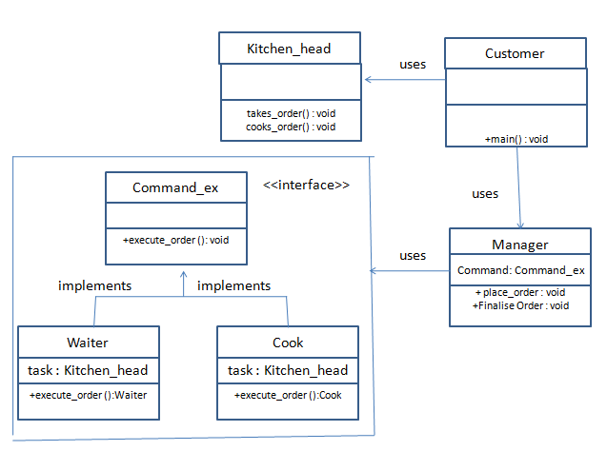
https://www.opencodez.com/java/command-design-pattern.htm https://www.scaler.com/topics/design-patterns/command-design-pattern/

Slide 6
Core Concepts of the Command Design Pattern
The Command Interface
The Command Interface is the cornerstone of this design pattern. It typically includes a single execution method that encapsulates the action to be performed. This interface serves as a contract for all concrete command classes, ensuring a consistent structure for command implementation.
Concrete Commands
Concrete Commands are classes that implement the Command Interface. Each class represents a specific action or request. These commands hold the necessary information to execute the action, such as method name, parameters, and the receiver object.
Invoker
The Invoker component is responsible for initiating the command. It holds a command and can call the command’s execution method to start the action. The Invoker doesn’t need to know about the concrete command class, as it works with commands through the Command Interface.

Slide 7
Core Concepts of the Command Design Pattern
Receiver
The Receiver is the object that knows how to perform the actual action. The command passes its request to the receiver to execute the desired operation. In many implementations, the command object holds a reference to the receiver.
Client
The Client in the Command Design Pattern creates the concrete command objects and sets their receiver. It can also assign commands to the invoker. In some cases, the client can configure commands with additional context or parameters required for execution.

Slide 8
Implementation of the Command Design Pattern
Define the Command Interface: Start by creating a command interface with an execute method. This method will be called to trigger the command.
Create Concrete Command Classes: Implement the command interface in different concrete command classes. Each class should encapsulate the action to be performed and its parameters.
Identify the Receiver: Determine the receiver class that knows how to perform the actual operation. The command will delegate the execution to the receiver.
https://naveen-metta.medium.com/mastering-the-command-pattern-in-java-a-comprehensive-guide-to-flexible-code-design-and-advanced-d6d7b2748c11

Slide 9
Implementation of the Command Design Pattern
Implement the Invoker: Create the invoker class that will hold and execute commands. The invoker calls the command’s execute method without needing specific knowledge of the concrete command.
Configure the Client: The client creates concrete command objects and associates them with their respective receivers. It also assigns commands to the invoker.
Execute Commands: Through the invoker, execute commands when required. The invoker triggers these commands, which in turn call the receiver’s actions.

Slide 10

Mediator Design Pattern
In some cases, the program is made up by using many numbers of classes and these classes need to communicate with each other. In addition to this if these classes are tightly coupled with each other then in it would be a code management issue in long run.
By using the mediator design pattern, communication between objects is encapsulated within a mediator object. Instead of classes communicating directly with each other, classes send messages to the mediator and the mediator send these messages to the other classes. So, in short, this pattern can be used when you see:

Slide 11
Advantages of the Mediator Design Pattern:
Decoupling of components: The Mediator pattern reduces direct dependencies between components by introducing a central mediator object. Components communicate through the mediator, promoting loose coupling.
Simplified communication: The Mediator pattern simplifies communication between objects by providing a centralized communication channel. It abstracts the complex communication logic and encapsulates it within the mediator.
Extensibility: Adding or modifying new components becomes easier as the communication logic is concentrated within the mediator. Changes to individual components have minimal impact on other components.
Improved maintainability: The Mediator pattern enhances code maintainability by centralizing the communication logic in a single class. This makes it easier to understand, modify, and debug the interactions between objects.
https://www.opencodez.com/java/mediator-design-pattern.htm
https://www.scaler.com/topics/design-patterns/mediator-design-pattern/

Slide 12
Memento Design pattern
Memento Pattern (a.k.a. Snapshot Pattern) is a Behavioral design pattern, and it’s used to save and restore previous state of an object. If you want to develop an application, that has undo or rollback functionality, you should go with Memento Design Pattern.
The Memento Design Pattern has 3 components know as, Originator, Caretaker, and Memento.
Originator: The object that we need to maintain the state. Basically, the Originator object creates a memento object to store its internal state. As a result, the Originator object knows how to save and restore itself.
Caretaker: The object that keeps the track about Originator. Basically, Caretaker knows why and when the Originator needs to save and restore itself.
Memento: The object that contains basic state storage and retrieval capabilities. Usually, the Memento object is immutable and pass it’s the data only once, through the constructor.

Slide 13
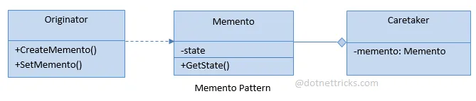
When implementing Memento Design pattern, the Originator coupled with the Memento and pass the state into the Caretaker. So, whenever we need go back into the previous state, we have to talk to the Caretaker and we check the previous state, then move.

Slide 14
State Design Pattern
“State” pattern, which is based on the idea of representing object states with a series of separate objects. Thus, the behavior of an object can change as its state changes, while the object itself remains unchanged.
Use the State design pattern when you have an object that behaves differently depending on its current state, the number of states is large and the state-specific code changes frequently.
The pattern should be used whenever you have a class polluted with massive conditionals that alter the behavior of the class according to the values of its fields.
If you have a lot of duplicate code across similar states and transitions of a condition-based state machine, use the State design pattern.

Slide 15
Pros of State Design Pattern
Separate the code related to different states into separate classes.
Introduce new states without changing existing state classes.
Simplify the context code by eliminating bulky state machine conditionals.
https://www.learncsdesign.com/learn-the-state-design-pattern/
https://www.scaler.com/topics/memento-design-pattern/

Slide 16
Visitor Design pattern
Visitor is a useful pattern when you have many objects of different types
in your data structure and you want to apply some operation to several or all of them.
The pattern is helpful when you don’t know ahead of time all the operations you will need;
it gives you flexibility to add new operations without having to add them to each object type.
The basic idea is that a Visitor object is taken around the nodes of a data structure by some kind of iterator,
and each node “accepts” the visitor, allowing it access to that node object’s internal data.
When a new function is needed, only a new visitor needs to be written. The iteration is conceptually simple:

Slide 17
Observer Design Pattern
This pattern is chosen when we have one-to-many relationships between objects. Using this pattern will make sure that this relationship is not tightly coupled. When one object changes state, its dependent objects are notified automatically. In short when your application has –
A one-to-many dependency between objects and you need to have these objects loosely coupled.
You need to have communication between these objects so if the state of one objects is changed, then others are notified.
https://www.opencodez.com/java/observer-design-pattern.htm

Slide 18
https://www.opencodez.com/java/state-design-pattern.htm
https://www.opencodez.com/java/strategy-design-pattern.htm
https://www.opencodez.com/java/template-method-design-pattern.htm
https://www.opencodez.com/java/visitor-design-pattern.htm

